Slide 1
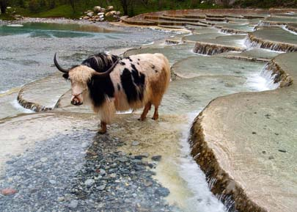
For each photo: 1. Write observations 2. Write any questions you have 3. Write a connection – what does the photo make you think of/remind you of? 4. Analyze – What do you think is happening? Why?

Slide 2
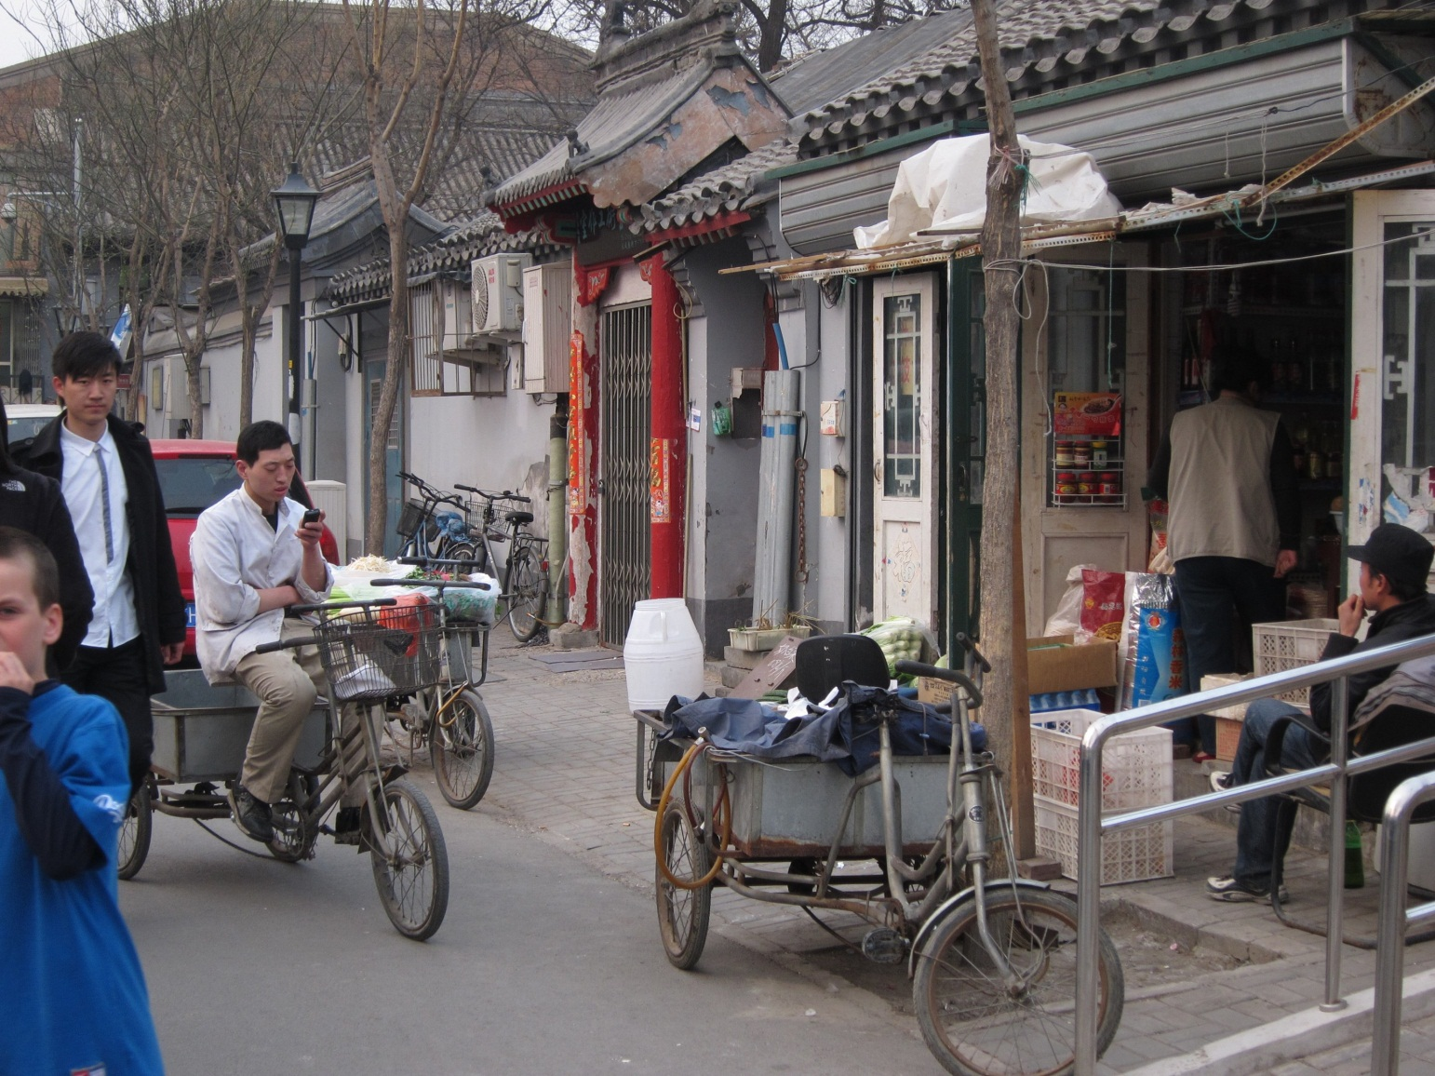
For each photo: 1. Write observations 2. Write any questions you have 3. Write a connection – what does the photo make you think of/remind you of? 4. Analyze – What do you think is happening? Why?

Slide 3
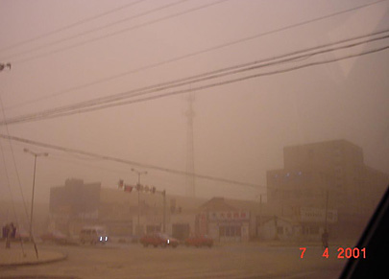
For each photo: 1. Write observations 2. Write any questions you have 3. Write a connection – what does the photo make you think of/remind you of? 4. Analyze – What do you think is happening? Why?

Slide 4
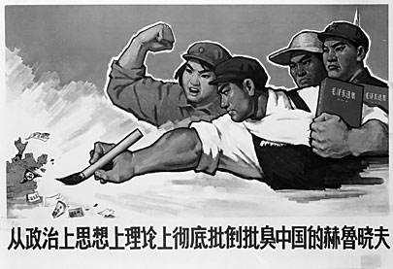
For each photo: 1. Write observations 2. Write any questions you have 3. Write a connection – what does the photo make you think of/remind you of? 4. Analyze – What do you think is happening? Why?

Slide 5
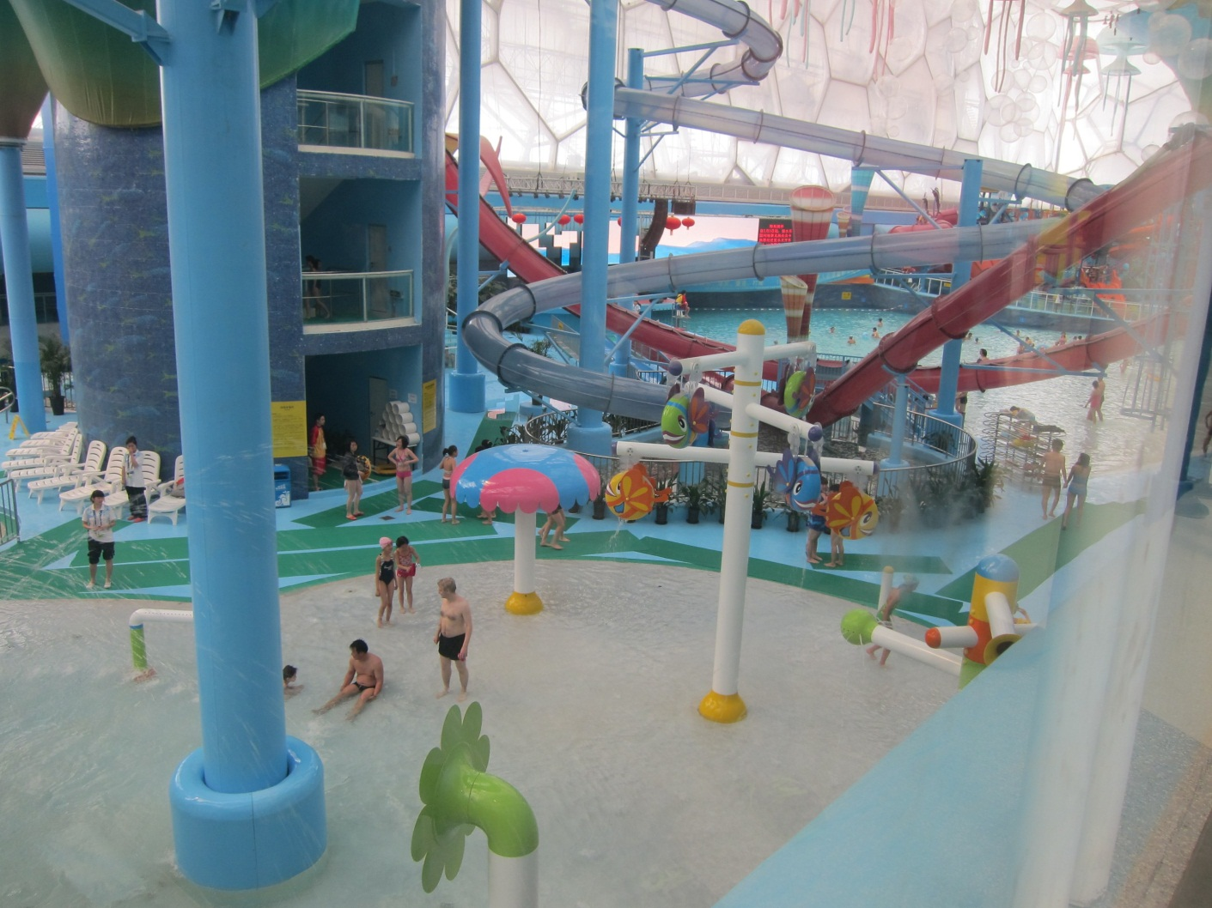
For each photo: 1. Write observations 2. Write any questions you have 3. Write a connection – what does the photo make you think of/remind you of? 4. Analyze – What do you think is happening? Why?

Slide 6
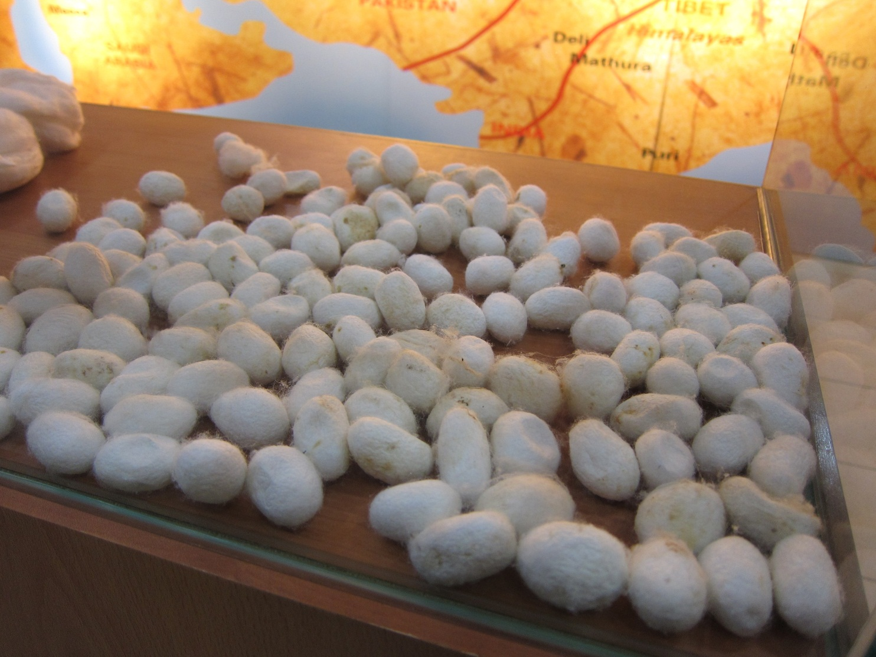
For each photo: 1. Write observations 2. Write any questions you have 3. Write a connection – what does the photo make you think of/remind you of? 4. Analyze – What do you think is happening? Why?

Slide 7
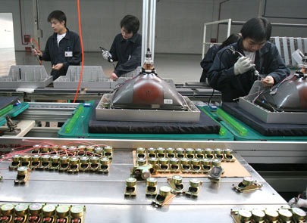
For each photo: 1. Write observations 2. Write any questions you have 3. Write a connection – what does the photo make you think of/remind you of? 4. Analyze – What do you think is happening? Why?

Slide 8
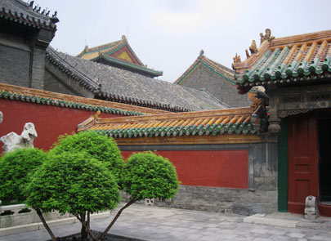
For each photo: 1. Write observations 2. Write any questions you have 3. Write a connection – what does the photo make you think of/remind you of? 4. Analyze – What do you think is happening? Why?

Slide 9
Reflection:
Based on these photos, write a paragraph (at least 5-6 sentences) comparing what you think life in China might be like compared to life in the United States.
Consider the following questions:
What is similar?
What is different?
What cultural differences did you notice?
How might their daily life be different from ours?
What might these pictures indicate about China’s climate/physical features

