Slide 1
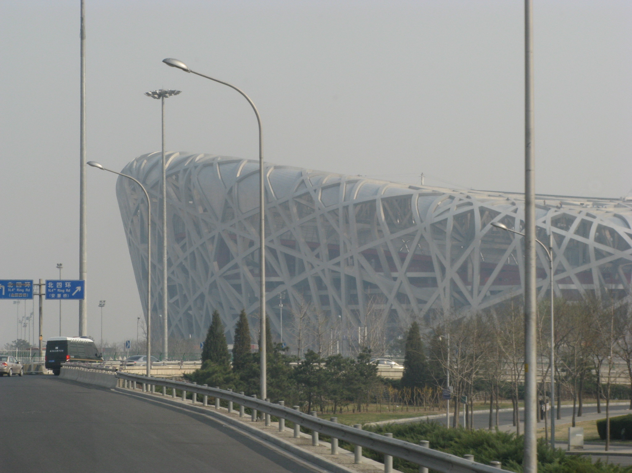
Cost Benefit Analysis & What’s The Problem With China?
Name(s)
Eastern Hemisphere
March 10, 2017

Slide 2
Cost Benefit Analysis of the Three Gorges Dam
Data
Pictures

Slide 3
What’s The Problem #1?
Data
Pictures

Slide 4
What’s The Problem #2?
Data
Pictures

Slide 5
What’s The Problem #3?
Data
Pictures

Slide 6
What’s The Problem #4?
Data
Pictures

Slide 7
What’s The Problem #5?
Data
Pictures

