Slide 1
Africa’s
Environmental
Issues
Pollution & Unequal Distribution of Water, Deforestation, & Desertification

Slide 2
Standards
SS7G2 The student will discuss environmental issues across the continent of Africa.
a. Explain how water pollution and the unequal distribution of water impacts irrigation, trade, industry, and drinking water.
b. Explain the relationship between poor soil and deforestation in Sub-Saharan Africa.
c. Explain the impact of desertification on the environment of Africa from the Sahel to the rainforest.

Slide 3
Teachers
Print off the following page for each student. They should complete the chart while discussing the presentation.

Slide 4
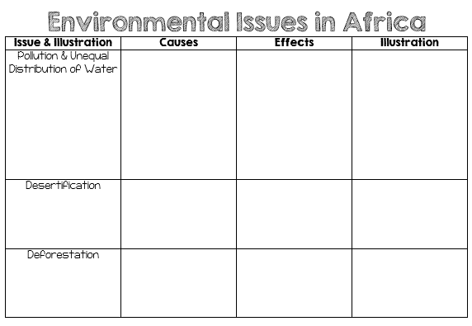

Slide 5
Africa’s
Environmental
Issues
Pollution & Unequal Distribution of Water, Deforestation, & Desertification

Slide 6
Water

Slide 7
Africa & Water
Water has always been vital to Africa.
The oceans, rivers, & seas that surround and run through Africa have allowed Africans to engage in trade and to have access to the outside world.
The interactions around these bodies of water have enabled certain cities to become thriving centers of commerce.

Slide 8
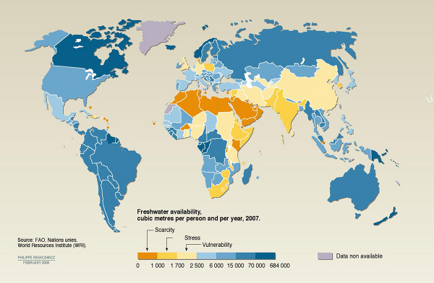

Slide 9
Limited Water Supply
Countries with large river systems have enough water for farming and for people in villages, towns, and cities.
Unfortunately, the majority of Africa has trouble getting enough water for people to survive.
Most African countries have very little clean water for drinking and washing.
Droughts (periods of very little rainfall) have hurt many parts of Africa.
People who live in areas affected by drought often face starvation and poverty.
The tension between the needs of a growing population and the limited supply of water is a serious issue for most of Africa.

Slide 10
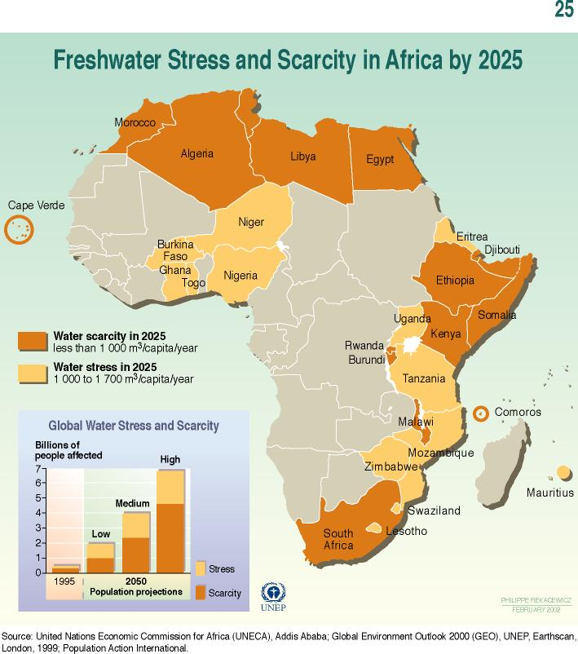

Slide 11
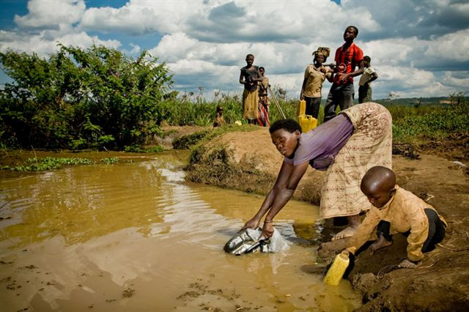

Slide 12
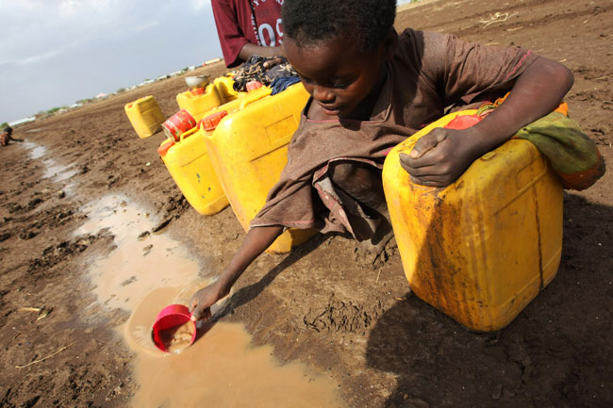
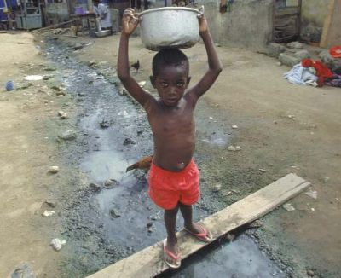

Slide 13
Water Pollution
Many countries in Africa do not have enough clean water, even the ones that have large rivers.
African countries have the problem of increasing pollution from factories and contamination from animals & human waste.
Overpopulation and poor sanitation regulations have made life along Africa’s water sources difficult.
Clean water is needed for basic health and sanitation.
Lack of clean water to wash with increases the frequency of skin and eye infections.
People who are not able to have access to clean water are at risk for many water-borne diseases that spread by parasites living in standing water.

Slide 14
Water Pollution
Some countries in Africa have tried to improve their economies by building factories.
Oftentimes, government officials ignore the industrial wastes that are bring flushed into rivers and streams as long as the factories are profitable.

Slide 15
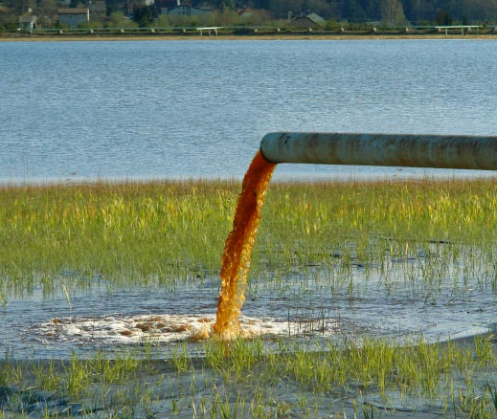

Slide 16
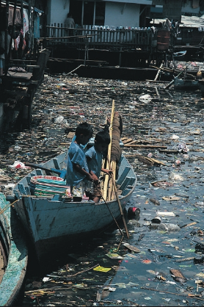
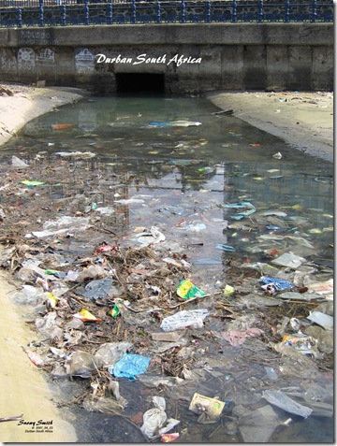

Slide 17
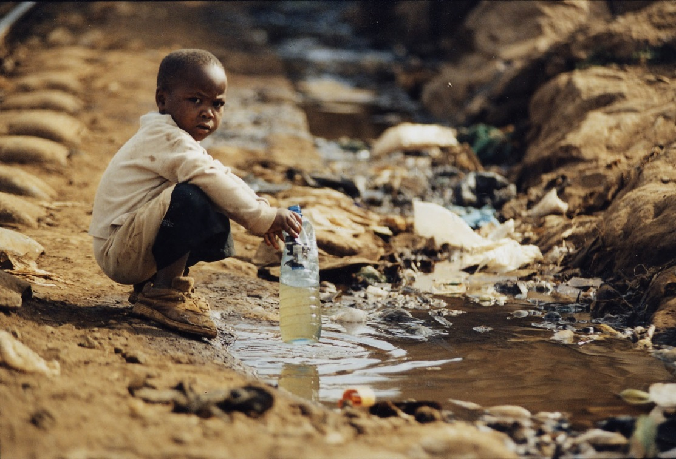

Slide 18
Desertification

Slide 19
Desertification
The Sahel is one part of Africa that is experiencing severe problems with desertification, the process of the desert expanding into areas that had formerly been farmland.
As the land is overused, the soil becomes poor and powdery.
The winds coming from the Sahara gradually blow the dry topsoil away, leaving a barren and rocky land that loses its ability to hold water.

Slide 20
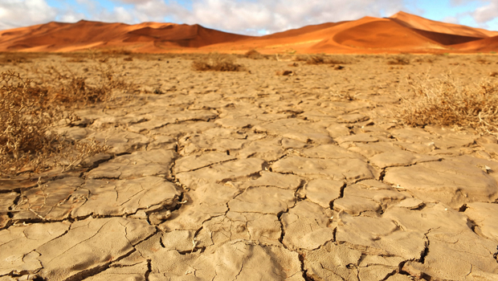
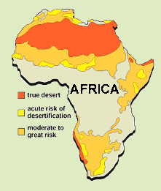

Slide 21
A Growing Desert
A majority of the desertification is the result of the actions of people rather than climate.
Desertification in Africa is caused by:
Poor farming practices.
People cutting down the trees that help hold the soil in place.
Animals being allowed to graze too heavily in an area and stripping all of the vegetation from the soil.
Draining the surface & underground water for industrial & home use.
The survival needs of the people living there are clear, but they are destroying major parts of their environment in the process.

Slide 22
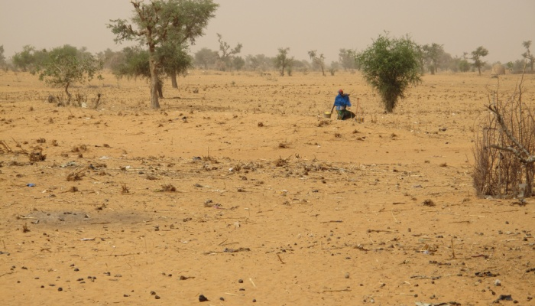
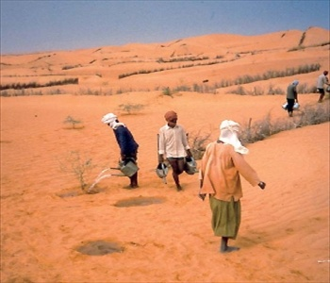

Slide 23
Effects
Africans who have lived for generations by farming and raising grazing animals are finding they have less and less land available to them.
The people who live in these areas often face starvation and poverty.
Many move into urban areas hoping to find work, but most find only more poverty.

Slide 24
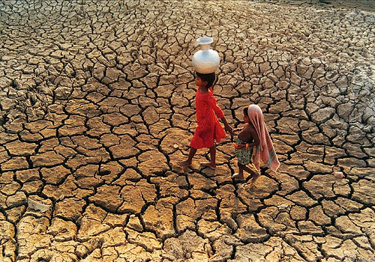

Slide 25
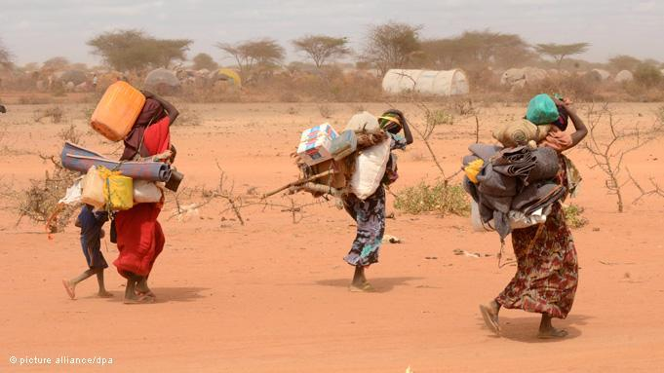

Slide 26
Solution?
Some Africans work hard to try to replant trees, to build windbreaks to keep out the sand, and to push the desert back whenever they can.
In many parts of Africa, this has become a losing battle, as the desert claims more land each year.
In recent years, the United Nations and the World Food Bank have come to the aid of those living in parts of the Sahel.
They have worked to find solutions to help the people survive and live a better life.

Slide 27
Deforestation

Slide 28
Deforestation
As Africa’s population increases and nations try to develop economically, deforestation has become a growing concern.
Deforestation is the process of forests being destroyed to make way for human development.
The main cause of deforestation in Africa’s rainforests today is commercial logging.
The timber from the rain forest is exported all over the world and helps boost the economy of many African countries.
Unfortunately, the environment is destroyed as a result.
Timber cutting businesses also need roads and heavy equipment to get the cut trees to the cities.
These also destroy more of the rain forests’ natural environment.

Slide 29
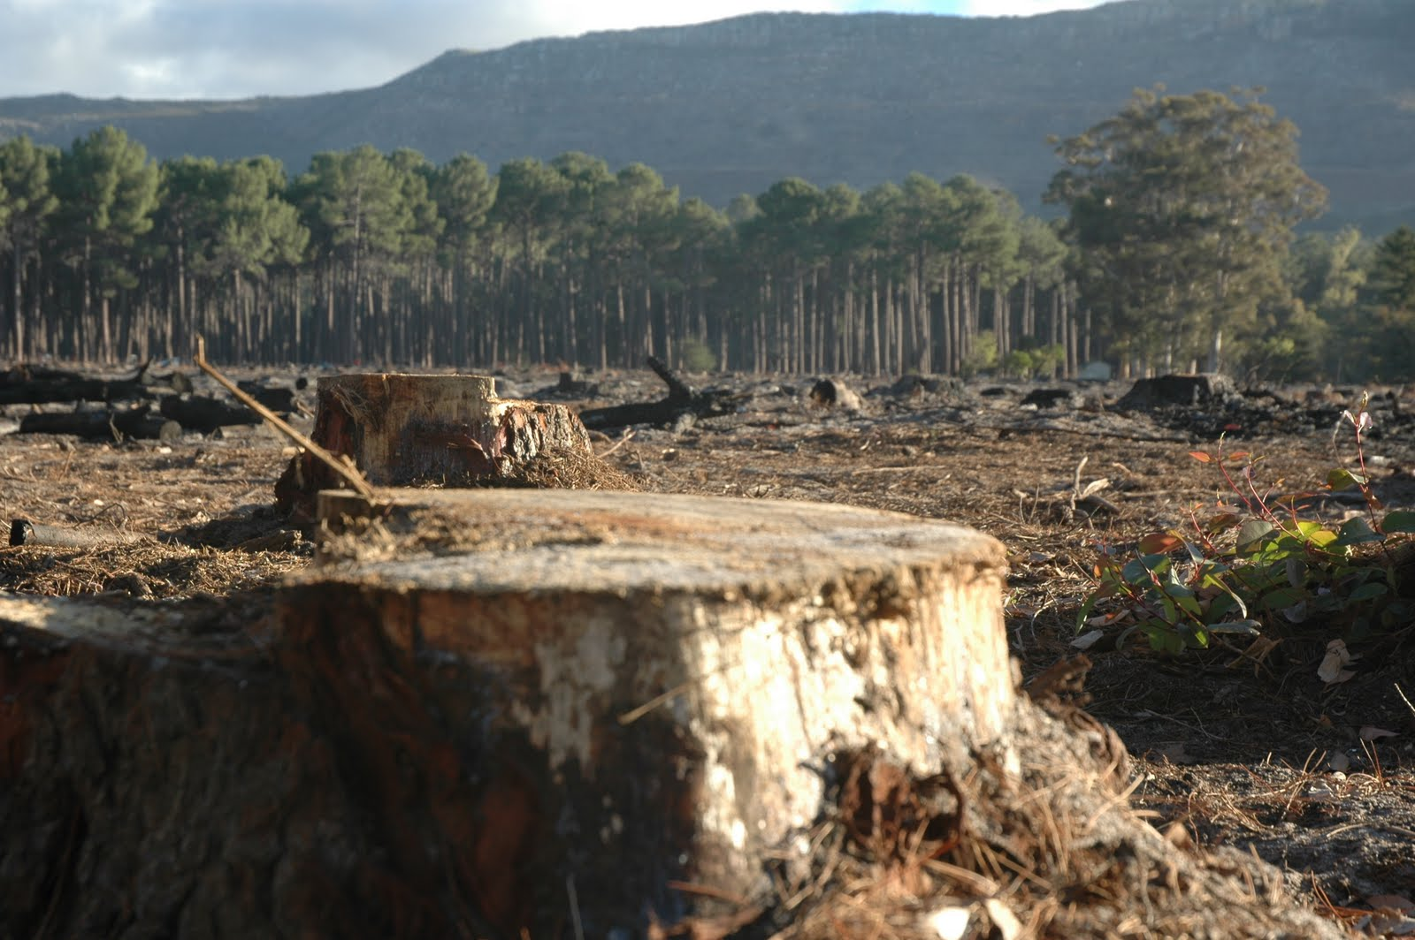
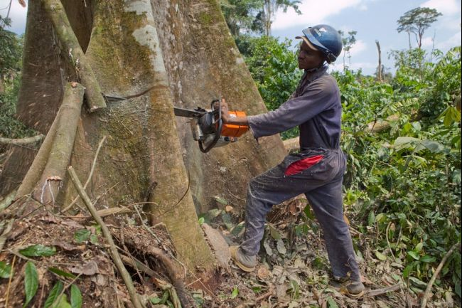

Slide 30
Effects
As the number of trees shrinks, so does the amount of oxygen produced.
Meanwhile, the amount of harmful carbon dioxide in the air increases.
Less rainforests could also mean fewer medicines.
About one-fourth of all medicines people use come from rainforest plants.
Deforestation also leads to extinction of species of both plants and animals.
Destruction of forests also contributes to soil erosion and desertification.

Slide 31
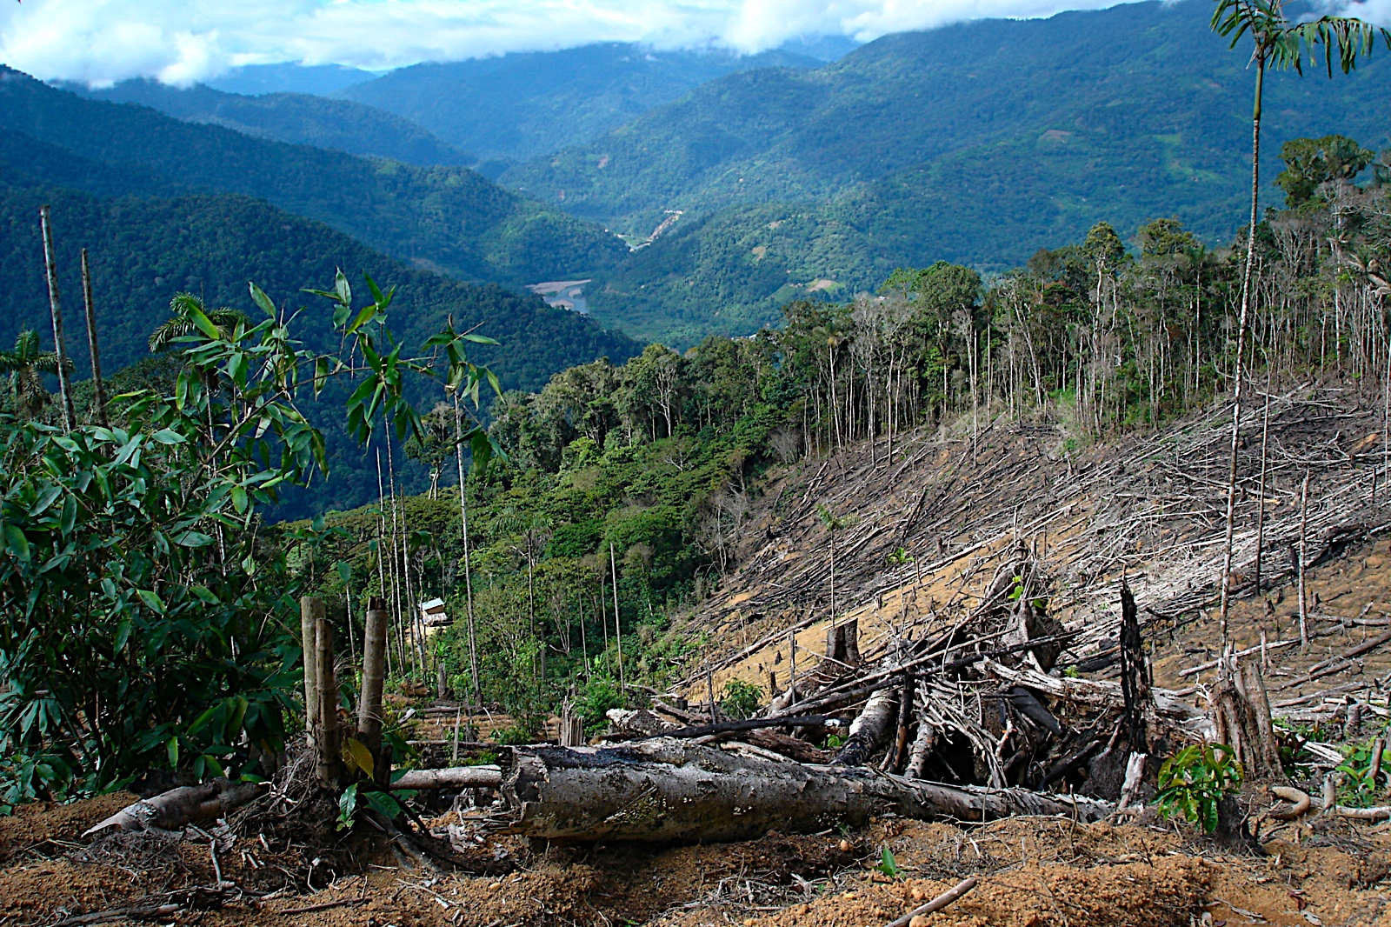

Slide 32
Effects
Many of the rainforests that once ran from Guinea to Cameroon are already gone.
Nigeria is losing its rainforests at the fastest rate.
The United Nations estimates that Nigeria has now lost about 55 percent of its original forests to logging, clearing land for farming, and cutting trees to use as fuel.

Slide 33
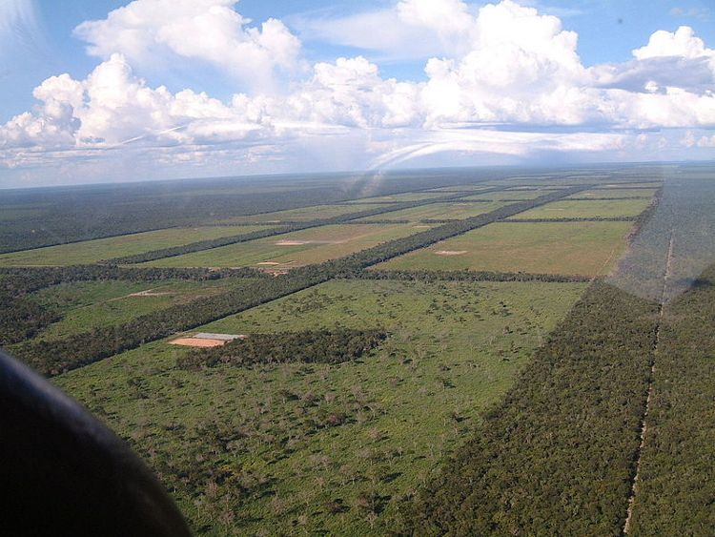
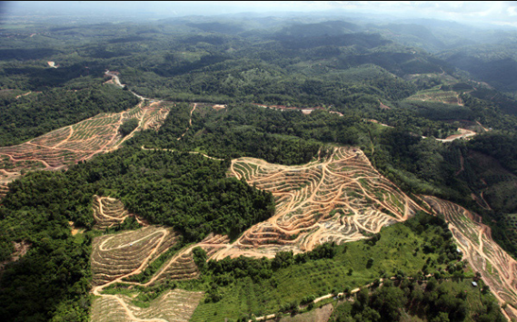

Slide 34
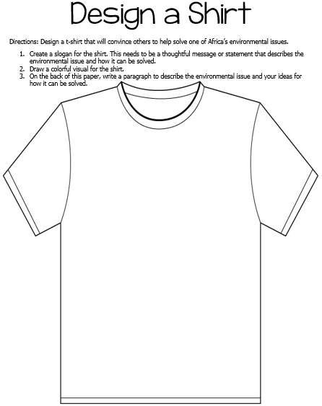

Slide 37
Teacher – Fortune-Ate Advice
Ticket Out the Door
Have students write advice for Africa regarding the environmental concerns that the continent is facing.
I like to have the students write fortunes at the end of class, and then explain them (on the back) at the beginning of the next class. I also pull up some example fortunes online to show the students examples.
*There are 2 per page.

Slide 38
Fortune-ate Advice
Fortune-ate Advice
Write a fortune cookie fortune for Africa regarding the environmental concerns that the continent is facing.
Write a fortune cookie fortune for Africa regarding the environmental concerns that the continent is facing

Slide 39
Teachers
Thank you for downloading this file. I hope you enjoy using it with your students, and I can’t wait to read your feedback in my TPT store! ☺
For more social studies materials, please visit my store: http://www.teacherspayteachers.com/Store/Brain-Wrinkles
I teach Language Arts and Social Studies in Georgia, so my products are aligned with Common Core (LA) and Georgia Performance Standards (SS).
© Copyright 2013. Brain Wrinkles. All rights reserved. Permission is granted to copy pages specifically designed for student or teacher use by the original purchaser or licensee. The reproduction of any other part of this product is strictly prohibited. Copying any part of this product and placing it on the Internet in any form (even a personal/classroom website) is strictly forbidden. Doing so makes it possible for an Internet search to make the document available on the Internet, free of charge, and is a violation of the Digital Millennium Copyright Act (DMCA).

Slide 40
Credits:
Facts & Statistics were found via CIA World Factbook in November 2013. All photos were found via Creative Commons and labeled for reuse.
Fonts:
Backgrounds & Graphics:

