Slide 1
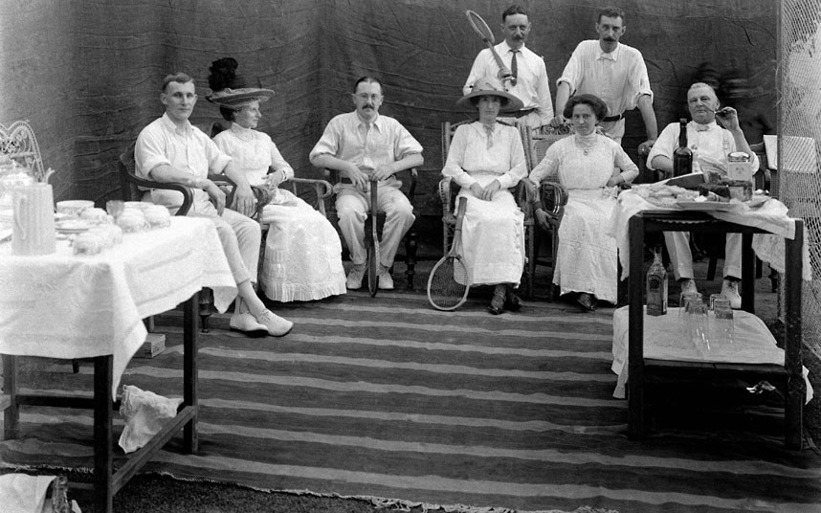
British Conquest of India
Slow process that took place over many years
The British colonial rule can be divided into three distinct periods:
A group of people posing for a photograph during a tennis party
Source:
http://www.telegraph.co.uk/news/picturegalleries/uknews/9252893/Photos-of-life-in-the-British-Raj-in-India-are-found-in-a-shoe-box.html?frame=2214153&page=1

Slide 2
Initial Establishment (1608-1757)
The British East India Company was established in 1600 and given a monopoly on overseas trade
The British East India Company: English company formed for the exploitation of trade with East and Southeast Asia and India,
Starting as a monopolistic trading body, the company became involved in politics and acted as an agent of British imperialism in India from the early 18th century to the mid-19th century.
The company was formed to share in the East Indian spice trade

Slide 3
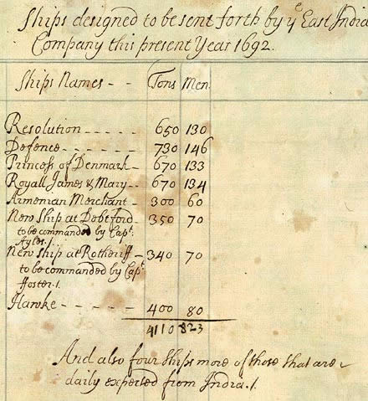
Study this source carefully. Different parts of the source will contain clues about why the British became empire builders in India. As you study the source, ask yourself:
How many ships was the British East India Company sending out in 1692? How many men were on the ships? What does this source tell you about the East India Company and the trade with the East? What does it tell historians about why the British became involved in India?

Slide 4
Company Rule (1757-1857)
Describes the century long period during which the East India Company consolidated the economic and political power it had collected in the early years of conquest.
During this period, the British made significant improvements to India’s infrastructure, including railways, canals, telegraph lines and mail service.
These improvement benefited natives, but were mostly for done to help British political, military and economic affairs.

Slide 5
British Raj - the former British rule of the Indian subcontinent - (1858-1947)
The Indian Mutiny of 1857 prompted the passage of the Government of India Act in 1858
The 1905 partition of Bengal into East Bengal and West Bengal due to religion created a backlash among the Indian population and spurred the desire for independence and self-rule.
Partition: something that divides

Slide 6
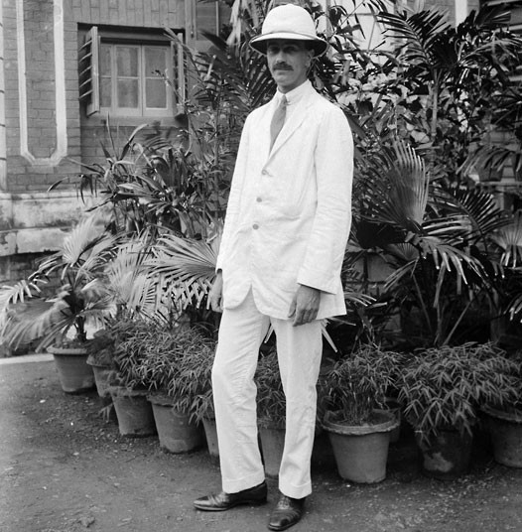
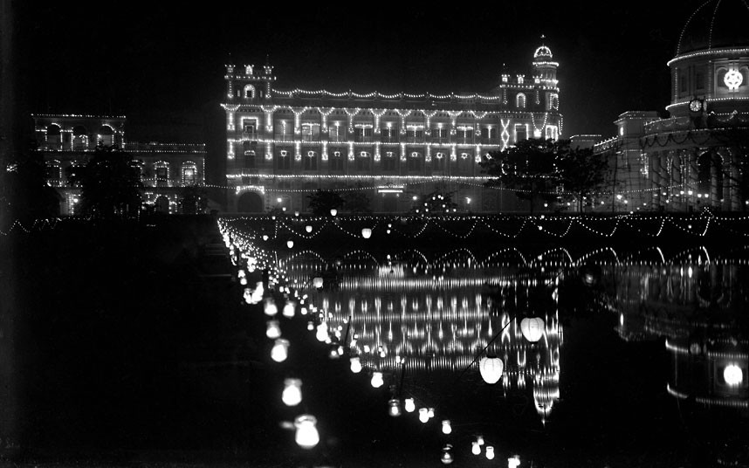
Source: http://www.telegraph.co.uk/news/picturegalleries/uknews/9252893/Photos-of-life-in-the-British-Raj-in-India-are-found-in-a-shoe-box.html?frame=2214142
Buildings in Calcutta lit up at night for the 1912 British royal visit
An unknown man posing for a photograph in a white linen suit

Slide 7
British Raj - the former British rule of the Indian subcontinent - (1858-1947)
The formation of the Indian National Congress and the Muslim League also heightened interest in independence.
The British colonial leader, Lord Louis Mountbatten, decided the only way to grant independence and avoid fighting was to divide the country into Hindu and Muslim sections.
On August 15, 1947, the British Raj was divided into the independent states of India, West Pakistan and East Pakistan and British rule ended.
Religion became the one factor that had the most important role in determining the nationalism of the people who chose to live in these new countries.

Slide 8
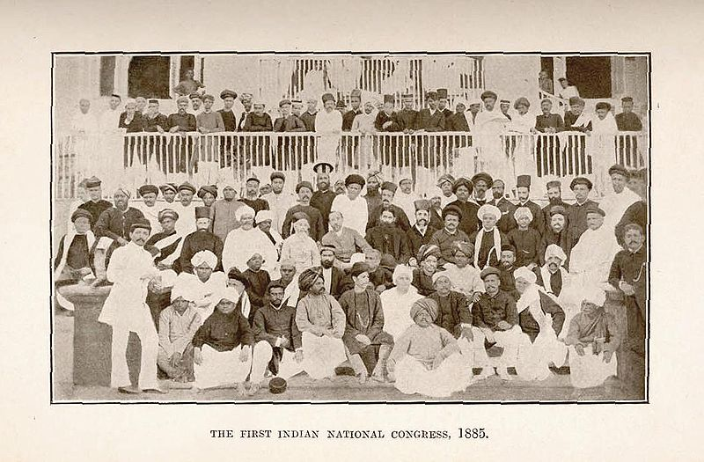

Slide 9
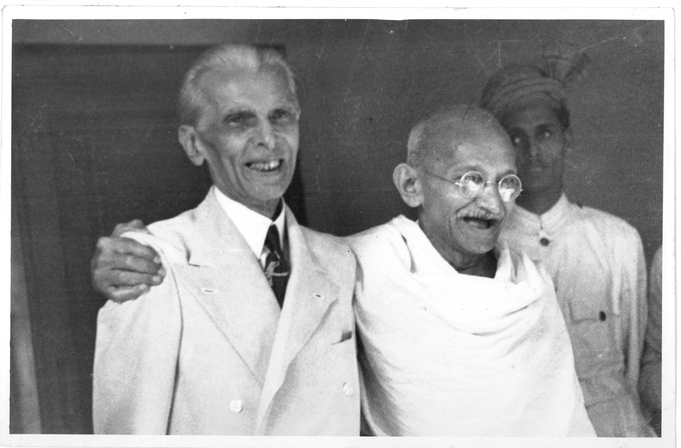
Gandhi (right) and Jinnah, President of the Muslim League, at the failed talks on a constitutional settlement, 1944
Source: http://www.leics.gov.uk/index/leisure_tourism/local_history/recordoffice/recordoffice_exhibitions/legacy_of_partition/record_office_legacy_of_partition_exhibition.htm

